Slide 1
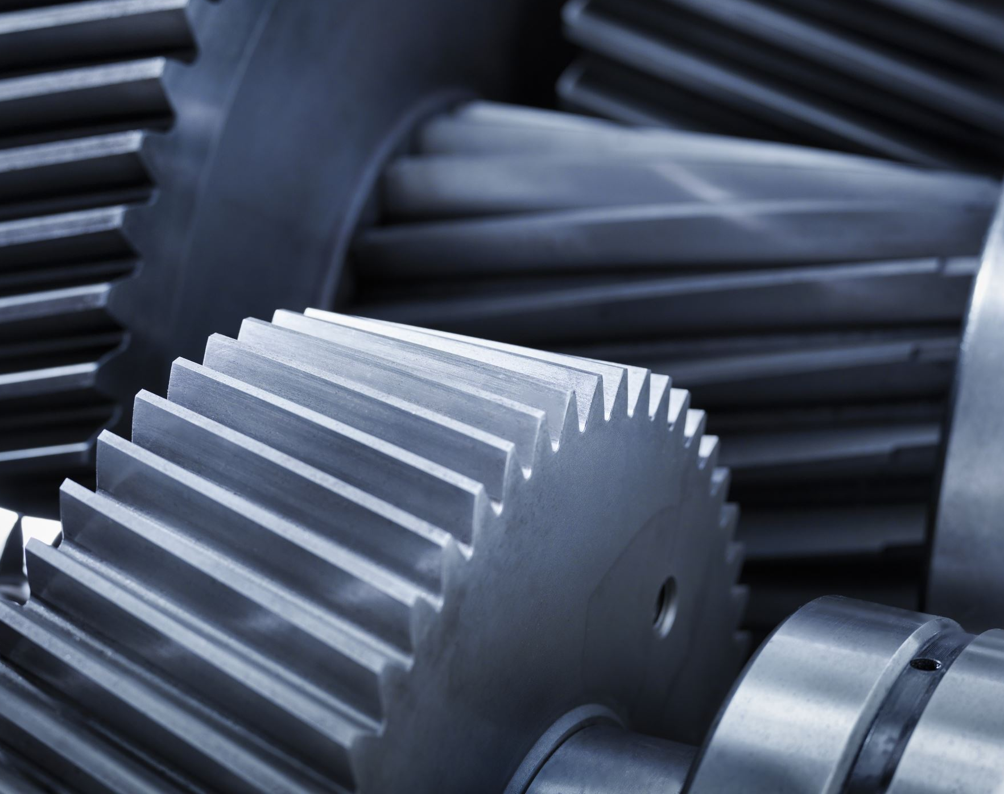
Predictive Maintenance on Water Pumps using semi-supervised learning and multitasking Mohammed Akheel - 23070149019 Aditya Anjanaikar - 23070149001 Soham Navale - 23070149022 Mentors Dr. Shivali Wagle Dr. Preksha

Slide 2

Introduction
In today’s industrial era, there is need of vast number of machines for building huge technology driven environment.
As a result, with the vast number of machines comes expensive repairs and services to maintain the production line.
Breakdown maintenance is the type of maintenance employed when the machines are set to be repaired only when they fail completely.
Preventive maintenance is the type of maintenance performed on a regular basis which are sometimes as per the manufacturer’s instructions. Eg : To perform annual service centre maintenance on a vehicle as per manufacturer’s instruction.

Slide 3
To maintain such complex machineries with so many moving parts, a proactive approach to maintenance called predictive maintenance employs data and analysis to spot possible issues before they cause an asset to fail.
Machine learning technique is being applied to train automated decision making algorithms based on the past data.

Slide 4
Problem Statement
To provide an industry-ready solution to reduce the downtime required to maintain the machineries, while also ensuring the optimal working of machineries and reducing the expenses and safety risks associated with faulty and damaged machinery components.

Slide 5
Technical milestones
To provide a solution to incomplete data that not only has missing values from independent features but also the target variable.
To fabricate a neural network that can perform multitasking where regression and classification is performed simultaneously while achieving the best results.

Slide 6
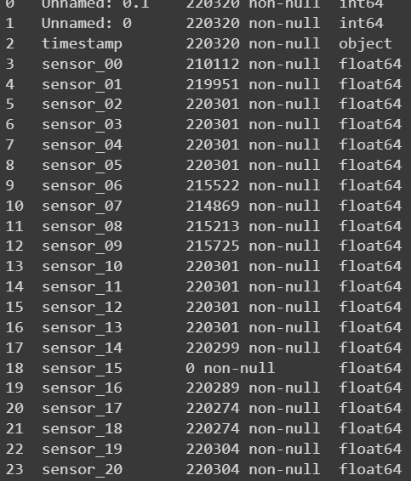
Dataset Description
Features- 56 (52 sensors & timestamp)
Rows- 220320
Data types- integer, float & object
Targets- Machine Status & RUL
Target type- categorical & continuous
Task type- classification and regression

Slide 7
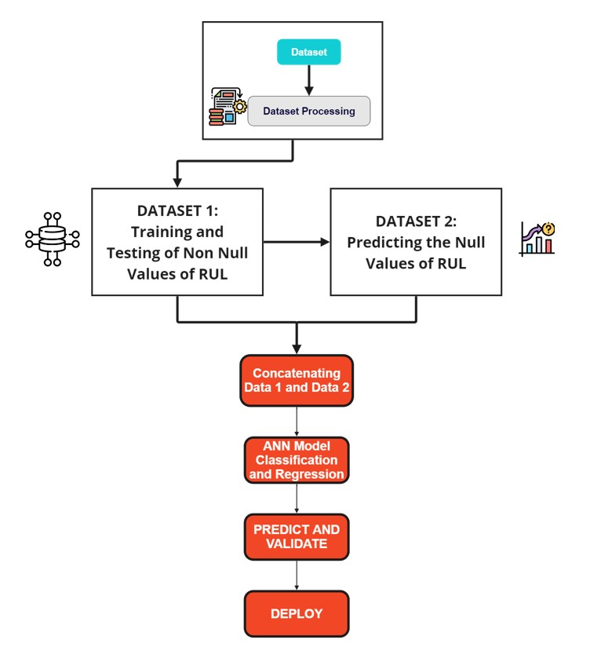
Proposed Workflow

Slide 8
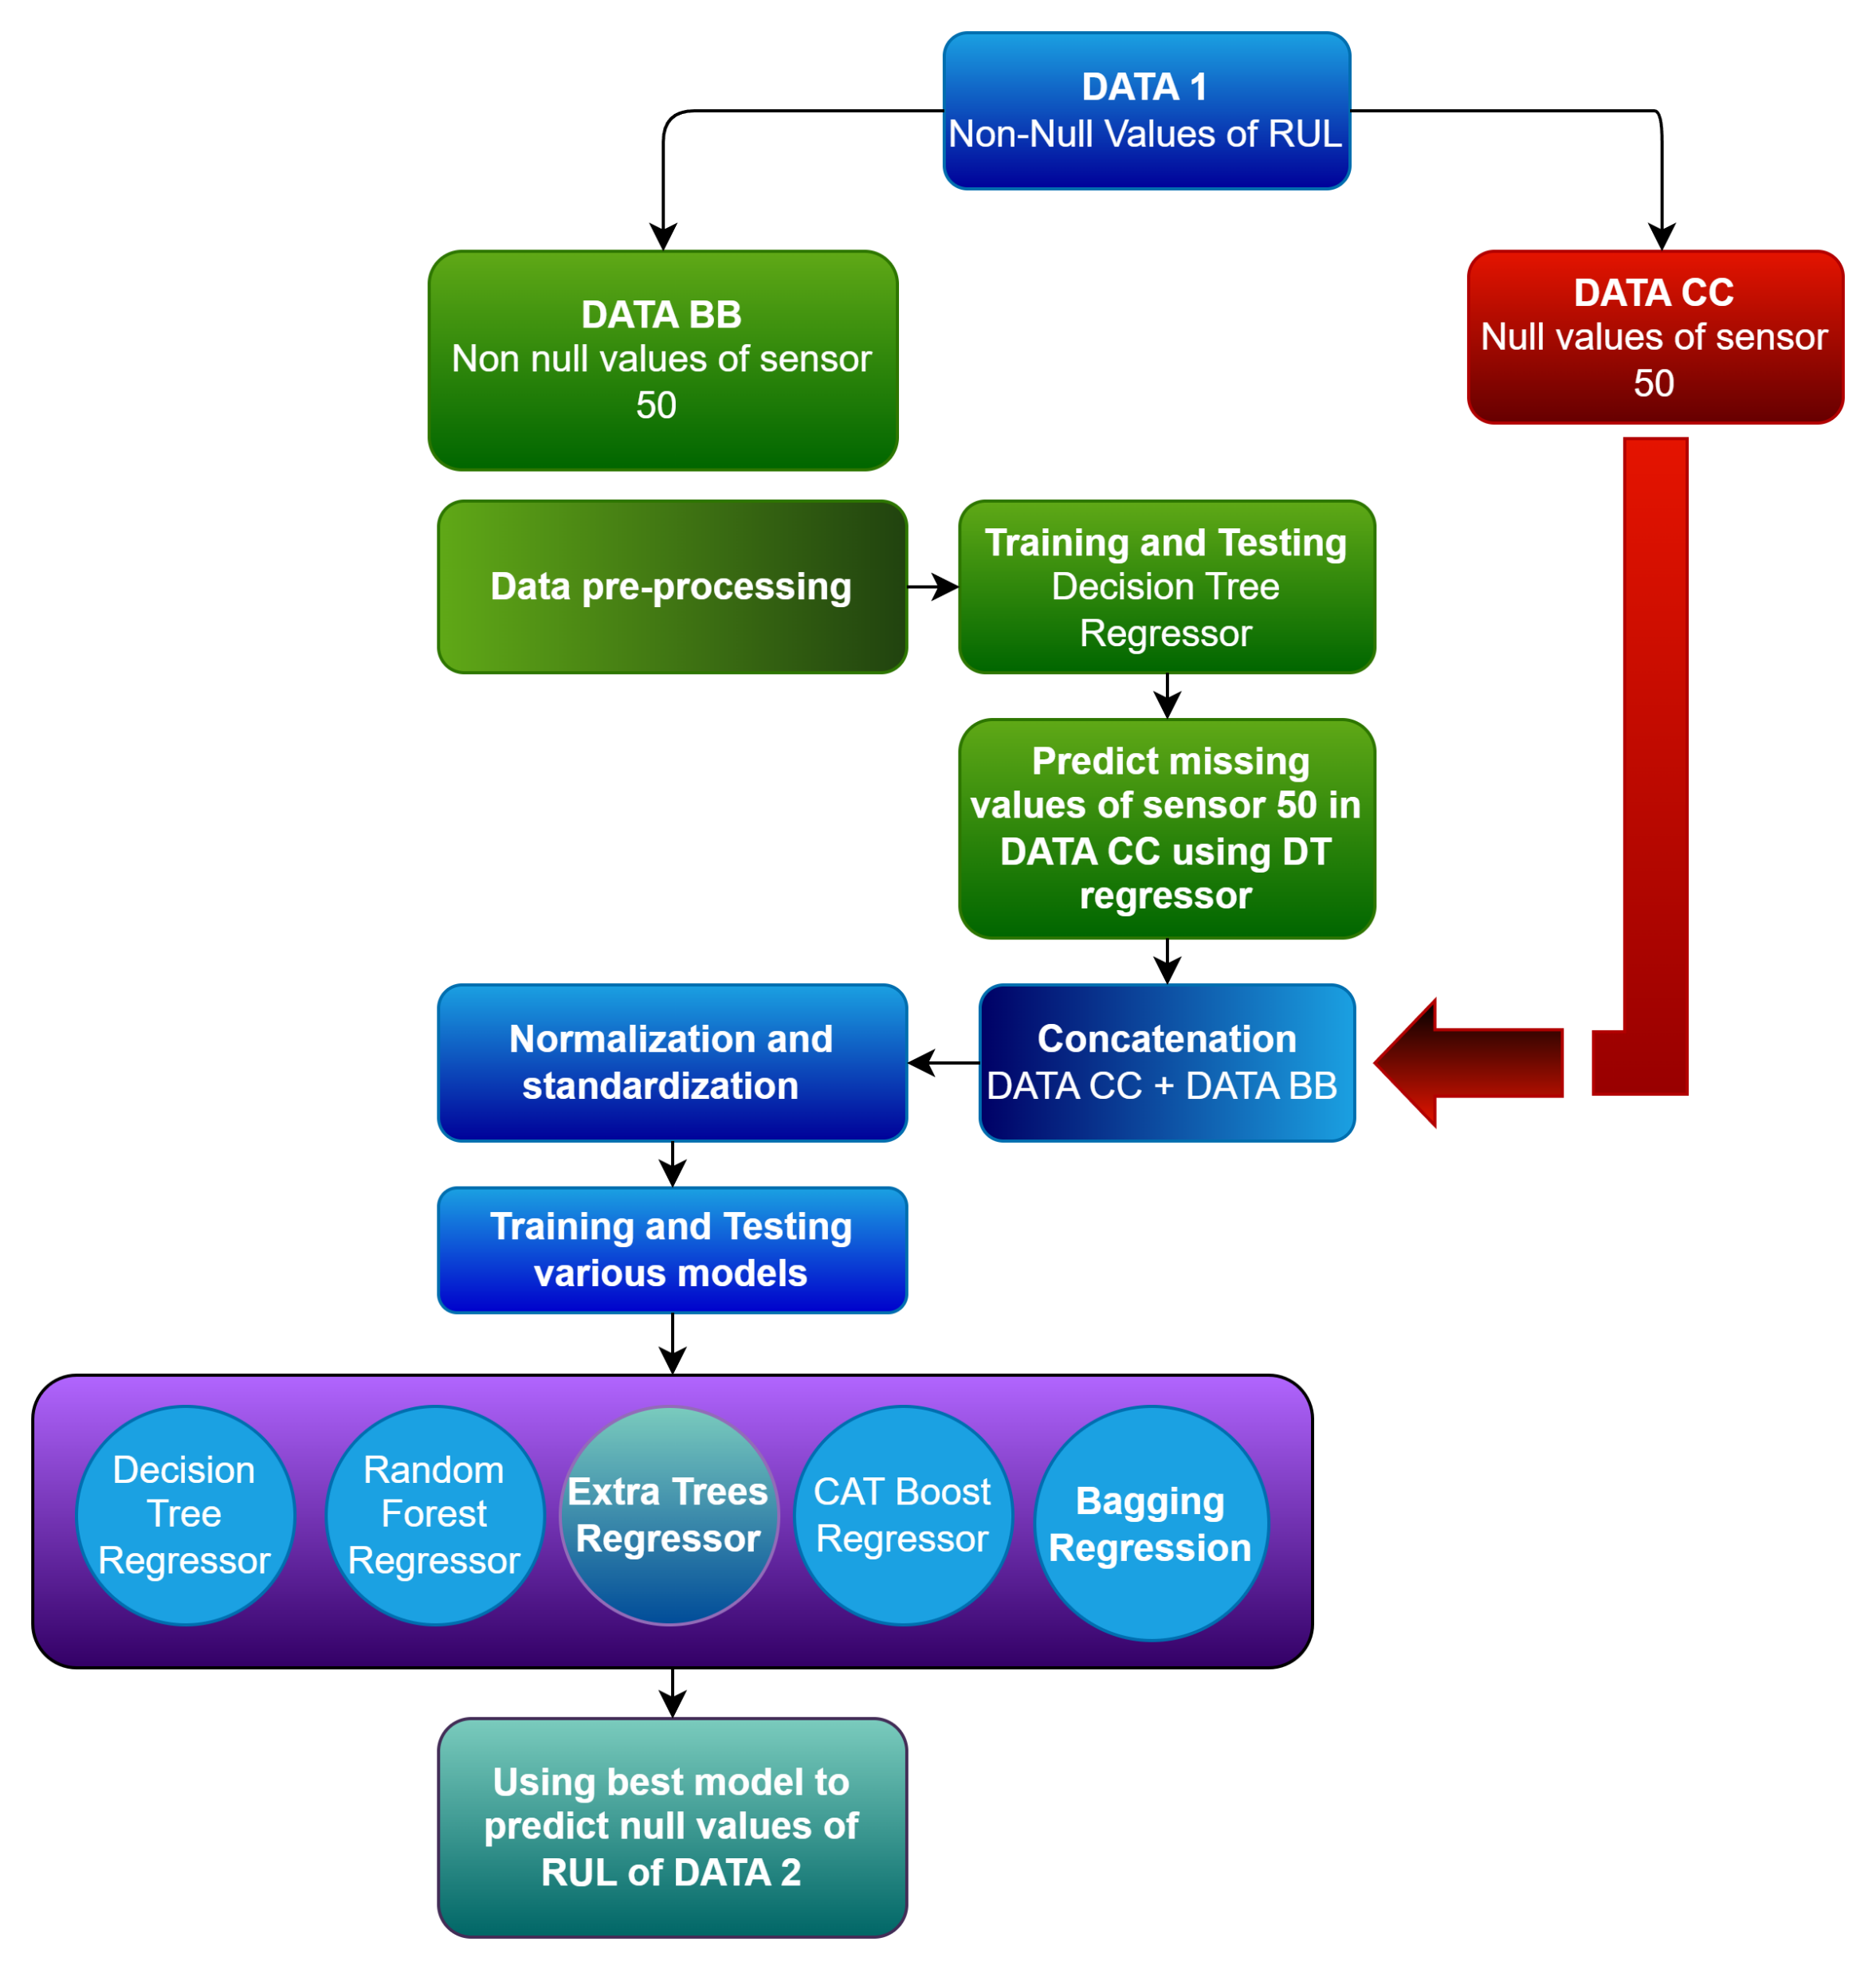

Slide 9
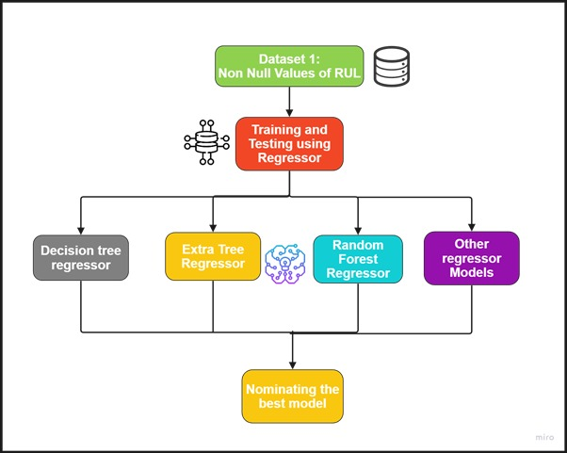

Slide 10


Data pre-processing
Imputation of all values except RUL and sensor 50 using forward fill technique
The month, day, hour and minute features were extracted from the timestamp.
The data was standardized and then normalized.
Imputation of sensor 50 and RUL were done by regression by applying semi-supervised technique, named self-training.
The dataset was made as the sensor 50 as target and rest as input features.
The dataset was trained using this data
The trained model was used to predict the missing values in sensor 50 and RUL

Slide 11

ANN description
Input layer - 54 features
128 neurons / units in the network
Activation function – ReLU for hidden layers, Softmax for output layers
Separate hidden layers for RUL and Machine Status
Dropout rate – 0.1
Learning rate – designed to decrease when there is no decline in loss value after 2 epochs.
1 epoch – 1 forward + 1 backward pass

Slide 12
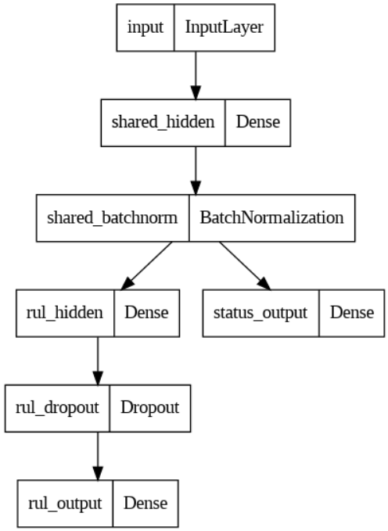
Flow of the Artificial Neural Network- ANN

Slide 13
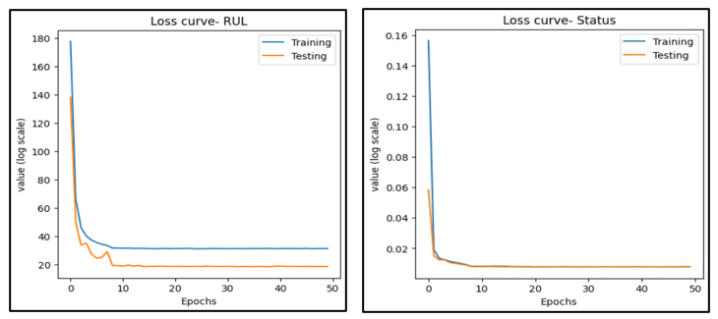
Evaluation – LOSS CURVE (RUL & Status)

Slide 14
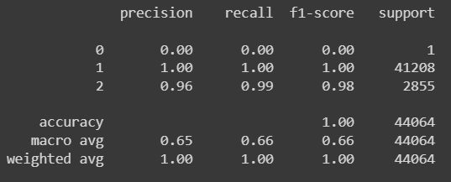
Evaluation –Precision, Recall, F1-Score, Support

Slide 15
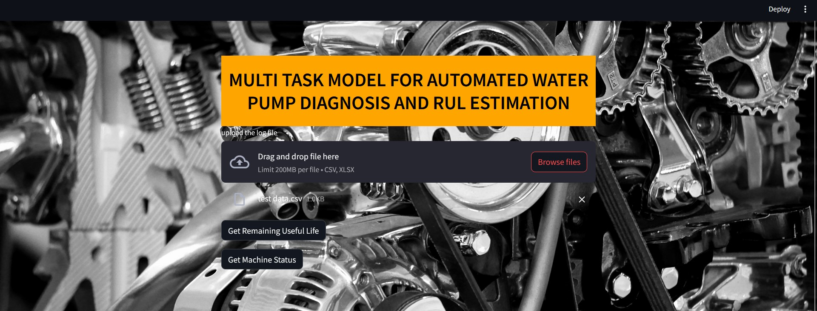
DEPLOYMENT – Graphical User Interface

Slide 16
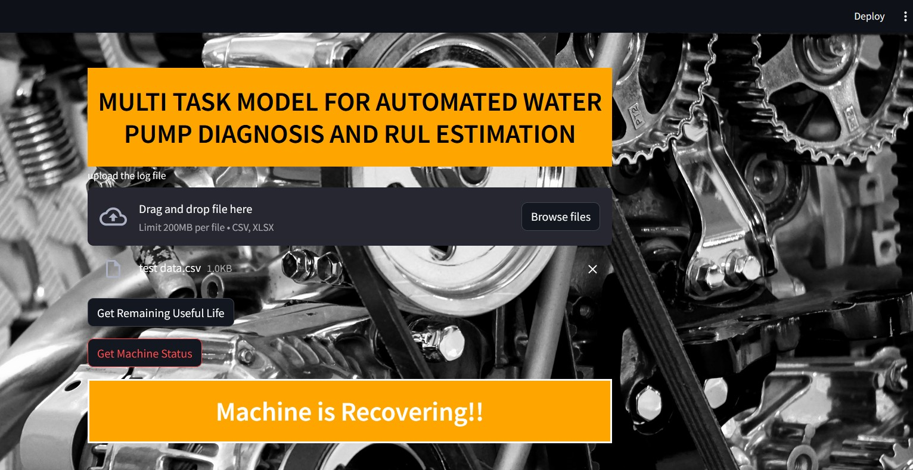

Slide 17
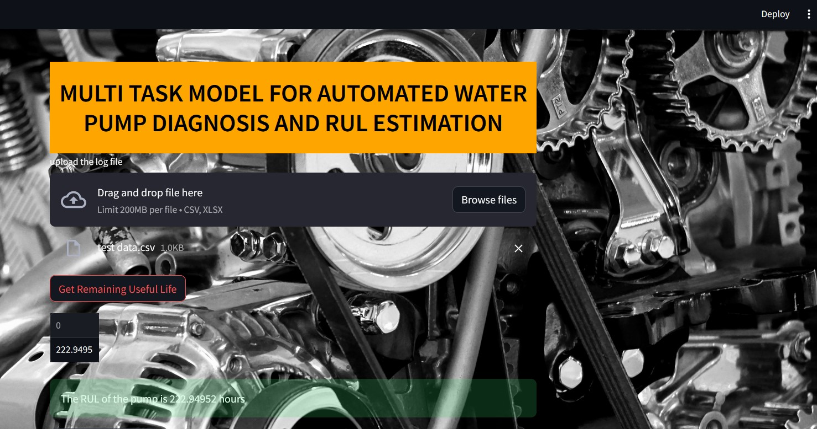

Slide 18
Conclusion
Water pumps are one kind of machinery that requires constant maintenance and regular inspections to ensure their longevity and prevent unexpected breakdowns.
We have shown how such issues can be mitigated using predictive maintenance by utilizing suitable machine learning models such as ANN.
Also, for mitigating vital missing data semi-supervised machine learning can be implemented to impute them.
Furthermore, this shows that predictive maintenance can help in keeping complex machinery at their best working conditions thus reducing downtimes and saving a lot in cost and time.

